Slide 1
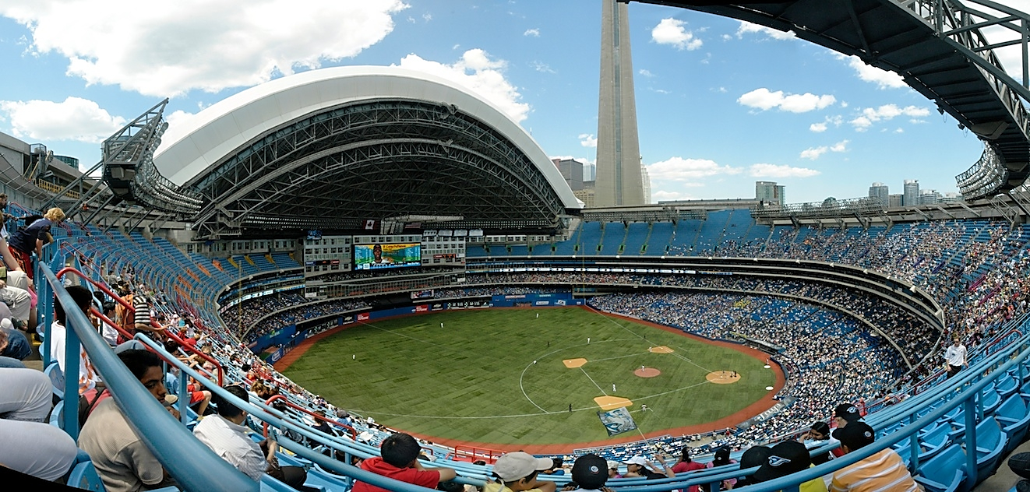
No place like a new home
The Skydome cost $570 million to build. But it wasn’t just a stadium, it was also a hotel, consisting of 348 rooms, 70 of which overlook the field.
On June 3, 1989, the Skydome became the second home of the Jays. It was a multipurpose stadium and became home to the Argonauts as well.
They Jays will never have a rained out game as long as they are playing at the Skydome. It was the very first stadium to have a fully retractable motorized roof. So if it’s raining (or snowing…it is Canada after all), just close it and 20 minutes later, game on!
If you’re looking for the Skydome, you won’t find it today. In 2005, Rogers Communications bought the Blue Jays and the Skydome. Even though it is now called the Rogers Centre, to many fans it will always be the Skydome.

